Slide 1
Azure App Insights: Add Application Telemetry & Monitoring to your Web Apps!

Slide 2
Host
Microsoft MVP
Office Apps & Services
Co-Host, Microsoft Cloud Show
@mscloudshow
http://www.MicrosoftCloudShow.com
Founder, Voitanos
@voitanos
https://www.voitanos.io

Slide 3
Overview
Introducing Azure Application Insights
Using Azure Application Insights with Server-Side Apps
Using Azure Application Insights with Client-Side Apps
Using Azure Application Insights with SharePoint Framework

Slide 4
Azure Application Insights
Centralized Logging, Metrics & Telemetry

Slide 5
Azure Application Insights (AppInsights)
https://azure.microsoft.com/services/application-insights
Application Performance Management Service (APM)
Get actionable insights through application performance & analytics
Works on multiple platforms, languages & frameworks
Part of Azure Monitor
https://docs.microsoft.com/azure/azure-monitor/overview

Slide 7
What Does it Do?
Out-of-the-box, it will track:
Request rates, response times, failure rates
Dependency rates, response times & failure rates
Exceptions
Page views & load performance
AJAX calls (rates, response times, failure rates)
User & session counts
Perf counters (CPU, memory, network usage)
Host diagnostics (docker, Azure)
You can add
Diagnostic trace logs
Custom events
Custom metrics
Custom data

Slide 8
What can you do with it?
Smart detection & manual alerts
Configure alerts to be notified about issues / breaking thresholds
Application map
Profiler
Usage Analytics
Diag search & instance data
Metrics explorer & aggregated data
Live metrics stream (near-real-time)
Customizable dashboards / connect to PowerBI
Portal saves 90 days; preservation options for long term analysis

Slide 9
Adding it to new / existing project
Option 1:
Many new projects created in Visual Studio get it automatically
Easily add via Visual Studio
Once installed, configure the AppInsights instrumentation key instance
Option 2:
Manually add by installing package for your platform (ie: client-side script)
Copy-paste in loading script
Automatically picks up server side details (CPU, requests, response, etc)
Packages provided for .NET, Node.js, Java, etc.

Slide 10
DEMO: Azure Application Insights

Slide 11
Case Study: How AppInsights Alerted Me to an Issue

Slide 12
Situation & Scenario
Voitanos.io:
Multiple SaaS linked to each other with webhooks, integrations & zaps (no code)
No server-side access
All services have webhooks that publish to a single listener (Azure Function)
Azure Function webhook listener linked to AppInsights instance for monitoring
Azure Function creates simulated events publishing an another unified AppInsights instance for overall reporting & platform health monitoring
Scenario:
Member management Saas (Kajabi) changed the payload of their webhook without notice
Broke integration with a few other SaaS and my simulated events

Slide 13
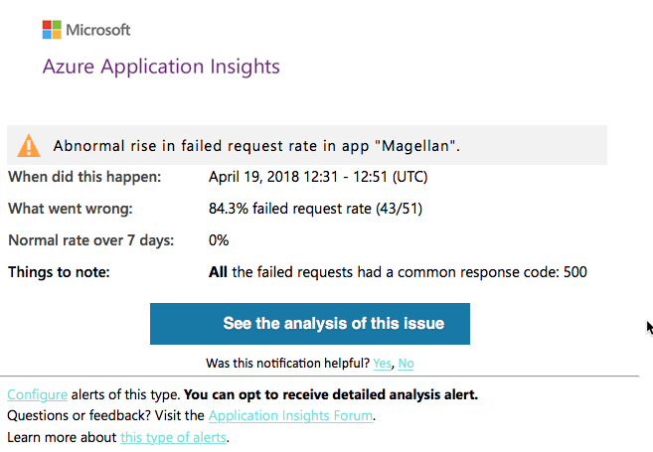
What Happened…
AppInsights sent a high priority email alerting me to abnormal rise in request failures

Slide 14
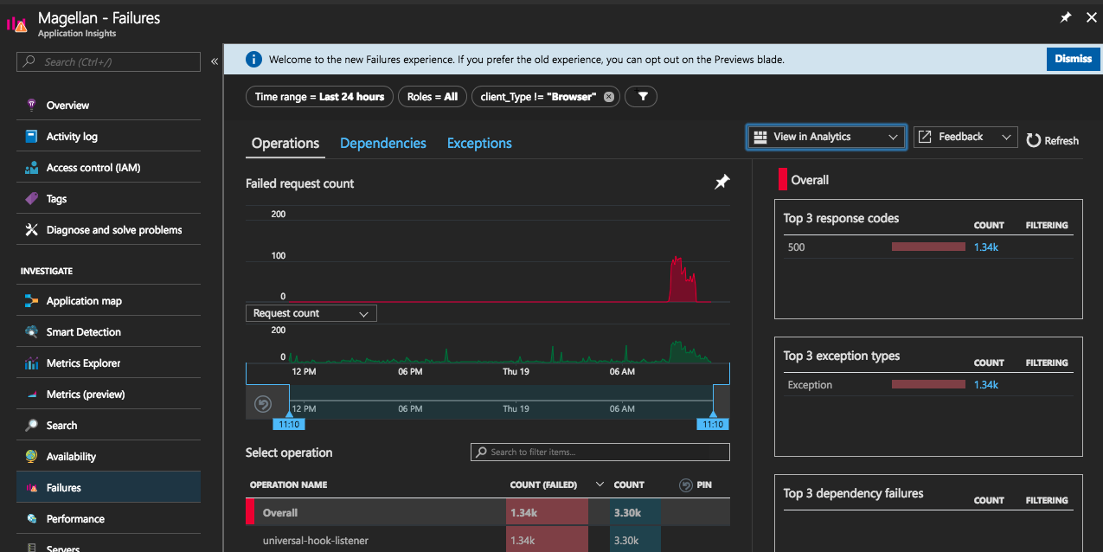
Investigating the issue

Slide 15
Custom Client-Side Solutions

Slide 16
Using App Insights for Custom Applications
App Insights does a lot for you out-of-the-box
Very powerful for custom solutions
Consider:
Centralized tracing & logging
Use custom events to track behaviors
Use the AppInsights portal features to create:
Alerts for specific events
Funnels to track the path of users
Specialized reports using Log Analysis
Custom dashboards

Slide 17
DEMO: Custom Client Side Solutions

Slide 18
Azure Application Insights + SharePoint Online
Add to every page in your tenant
Use SPFx Extension: Application Customizer
Initialize AppInsights JS on the page
Optionally identify the user
Log page view
Leverage SharePoint PnP PowerShell / Office 365 CLI to deploy to all sites
Once deployed & configured in your SPO tenant & sites
You can add page views & other custom tracing / events / metrics
SPFx customizations can be written to assume AppInsights is already on the page
If not, the script won’t error… it just won’t report back to AppInsights

Slide 19
Add App Version to All AppInsights Telemetry
Dynamically leverage version from package.json in your project
Leverage the webpack-auto-inject-version package
Add comment to the top of your bundle
Add line to configure AppInsights after download
Consider how this is used in SharePoint Online*
// install package
npm install webpack-auto-inject-version –save-dev
// configure App Insights
AppInsights.context.application.ver='[AIV]{version}[/AIV]';

Slide 20
Customize & Extend Webpack in SPFx projects
// gulpfile.js
const WebpackAutoInject = require('webpack-auto-inject-version’);
...
// add the following to the end of the file
build.configureWebpack.mergeConfig({
additionalConfiguration: (generatedConfig) => {
generatedConfig.plugins.push(new WebpackAutoInject({
components: { AutoIncreaseVersion: false, InjectAsComment: true, InjectAsTag: false },
InjectAsComment: { tag: 'Version: {version} - {date}’, dateFormat: 'h:MM:ss TT’ },
SILENT: true
})
);
return generatedConfig;
}
});

Slide 21
DEMO: AI + SharePoint Online

Slide 22
Azure App Insights Resources
Docs
https://azure.microsoft.com/services/application-insights
JavaScript Docs (client-side)
https://docs.microsoft.com/azure/application-insights/app-insights-javascript
JavaScript SDK
https://github.com/Microsoft/ApplicationInsights-JS
JavaScript SDK API
https://github.com/Microsoft/ApplicationInsights-JS/blob/master/API-reference.md
JavaScript Web SDK: v1 beta 10 “next version”
https://www.npmjs.com/package/@microsoft/applicationinsights-web

